Slide 1
Java Threading Essentials
A N M Bazlur Rahman (@bazlur_rahman)

Slide 2

Who I AM

Slide 3

Who here thinks thread programming is easy?

Slide 4

Agenda
What is thread
Why it is important
Extreme basics
Creating and running
Problems and how to avoid them
Available APIs in JDK to make our life easy
Learning resources
Notes:
Before taking off, let’s hear about the safety briefing. Which means agenda.

Slide 5
Java is made of Thread
From day 0, Java introduced Threads
Threads are units of execution in Java.
More threads == more Execution Environment
That means, we can do more things simultaneously
Notes:
Thread is the way of expressing concurrency java.

Slide 6
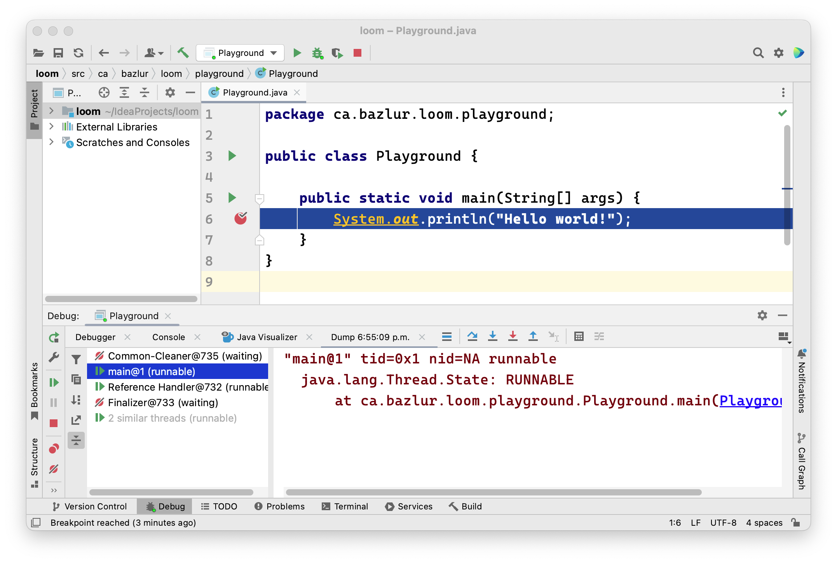
Threads are in all layer of the Java platform
Exceptions
ThreadLocals
Debugger
Profiler (JFR)

Slide 7

A day without thread programming

Slide 8
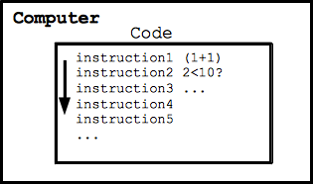
1 Program

Slide 9
Multiple Programs

Slide 10
DEMO

Slide 11
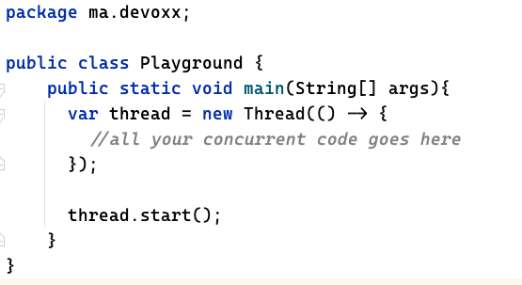
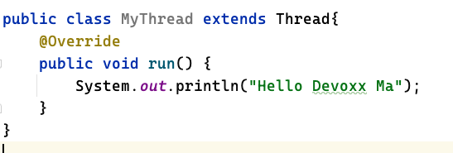
Creating and Running Threads

Slide 12
Shutting down the thread
Thread stops automatically when the work is done
Thread.stop() is deprecated, don’t use it.
It can lead to the data structure in an inconsistent state
We can use an interruption mechanism, Thread.interrupt()

Slide 13
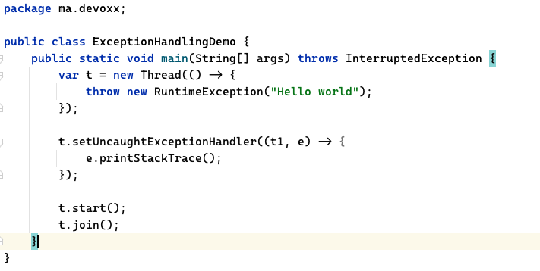
Exception handling

Slide 14
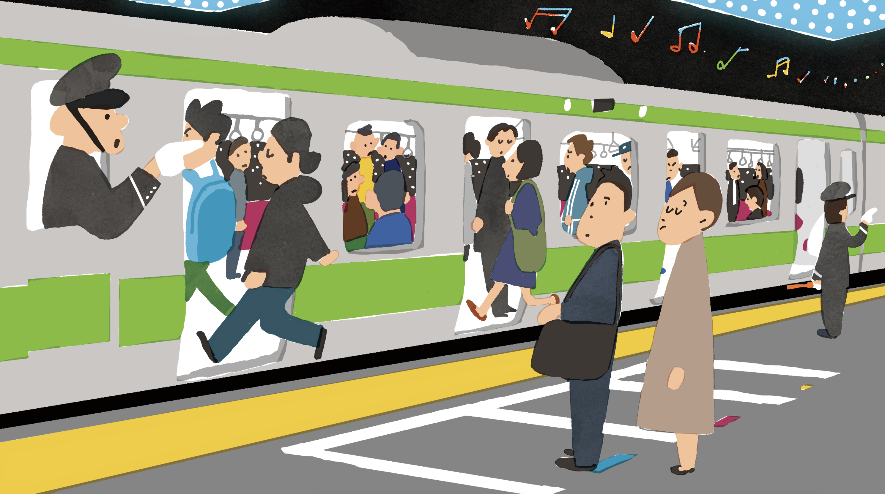
Problem

Slide 15
Shared Memory with multi-threading
How can multiple threads access one object?
Add and withdraw from a bank account
IO at the same time
If multiple threads access a memory location at the same time, we will get race conditions

Slide 16
BankAccount.java
public class BankAccount{ private double balance; public BankAccount(double initial) { this.balance = initial; } public void deposit(double amount){ balance = balance + amount; } public void withdraw(double amount){ deposit(-amount); } public double getBalance() { return balance; } }

Slide 17
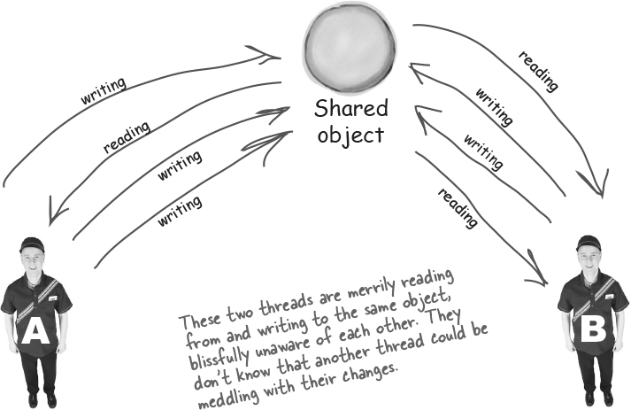
Shared Memory with Multithreading
Read/Write from the exact memory location
Deposit & withdraw from a bank account
Write on a file from two different threads at the same.
If several threads access a memory location simultaneously, inconsistency appears, which is called a race condition.

Slide 18
Race conditions are unpredictable
Anything can go wrong without proper synchronization
Demo

Slide 19

Solution
We need a lock

Slide 20
Synchronization
Java has a built-in mechanism for thread safety with synchronization keyword
Every object in java can be used as a monitor with synchronized
Only one thread can acquire the monitor object at a time.
If a thread acquires a lock other threads want to acquire, they are blocked until it is freed.

Slide 21
Synchronized
public class BankAccountSynchronized { private double balance; public BankAccountSynchronized(double initial) { this.balance = initial; } public synchronized void deposit(double amount){ balance = balance + amount; } public synchronized void withdraw(double amount){ deposit(-amount); } public synchronized double getBalance() { return balance; } }

Slide 22
Synchronized(2)
public class BankAccountSynchronized2 { private double balance; private final Object lock = new Object(); public BankAccountSynchronized2(double initial) { this.balance = initial; } public void deposit(double amount) { synchronized (lock) { balance = balance + amount; } } public synchronized void withdraw(double amount) { synchronized (lock) { balance = balance - amount; } } }

Slide 23
Benefit over not using synchronized in method signature
Once your method is written and shared with the client, you can no longer change it.
On the other hand, if you use the alternative method, you can change it later with something else.
Also, using the synchronized keyword, the whole class is locked; on the other hand, using an unrelated field, only synchronized blocks are locked, and other threads can execute other methods.

Slide 24
Interthread communication
Threads sometime require communication with each other.
Producer/Consumer example
E.g. Consume needs to wait until when the buffer is empty.
When a resource is available, we will notify the waiting threads.
Basic thread communication:
Wait() – release the lock and waits
Notify(), notifyAll() send messages to all waiting threads.

Slide 25
Buffer.java
public class Buffer { private final static int SIZE = 10; private final Queue<Integer> queue = new LinkedList<>(); public synchronized void addItem(int item) { while (queue.size() == SIZE) { try { wait(); } catch (InterruptedException e) { e.printStackTrace(); } } queue.add(item); notifyAll(); } public synchronized Integer getItem() { while (queue.isEmpty()) { try { wait(); } catch (InterruptedException e) { e.printStackTrace(); } } Integer value = queue.poll(); notifyAll(); return value; } }

Slide 26
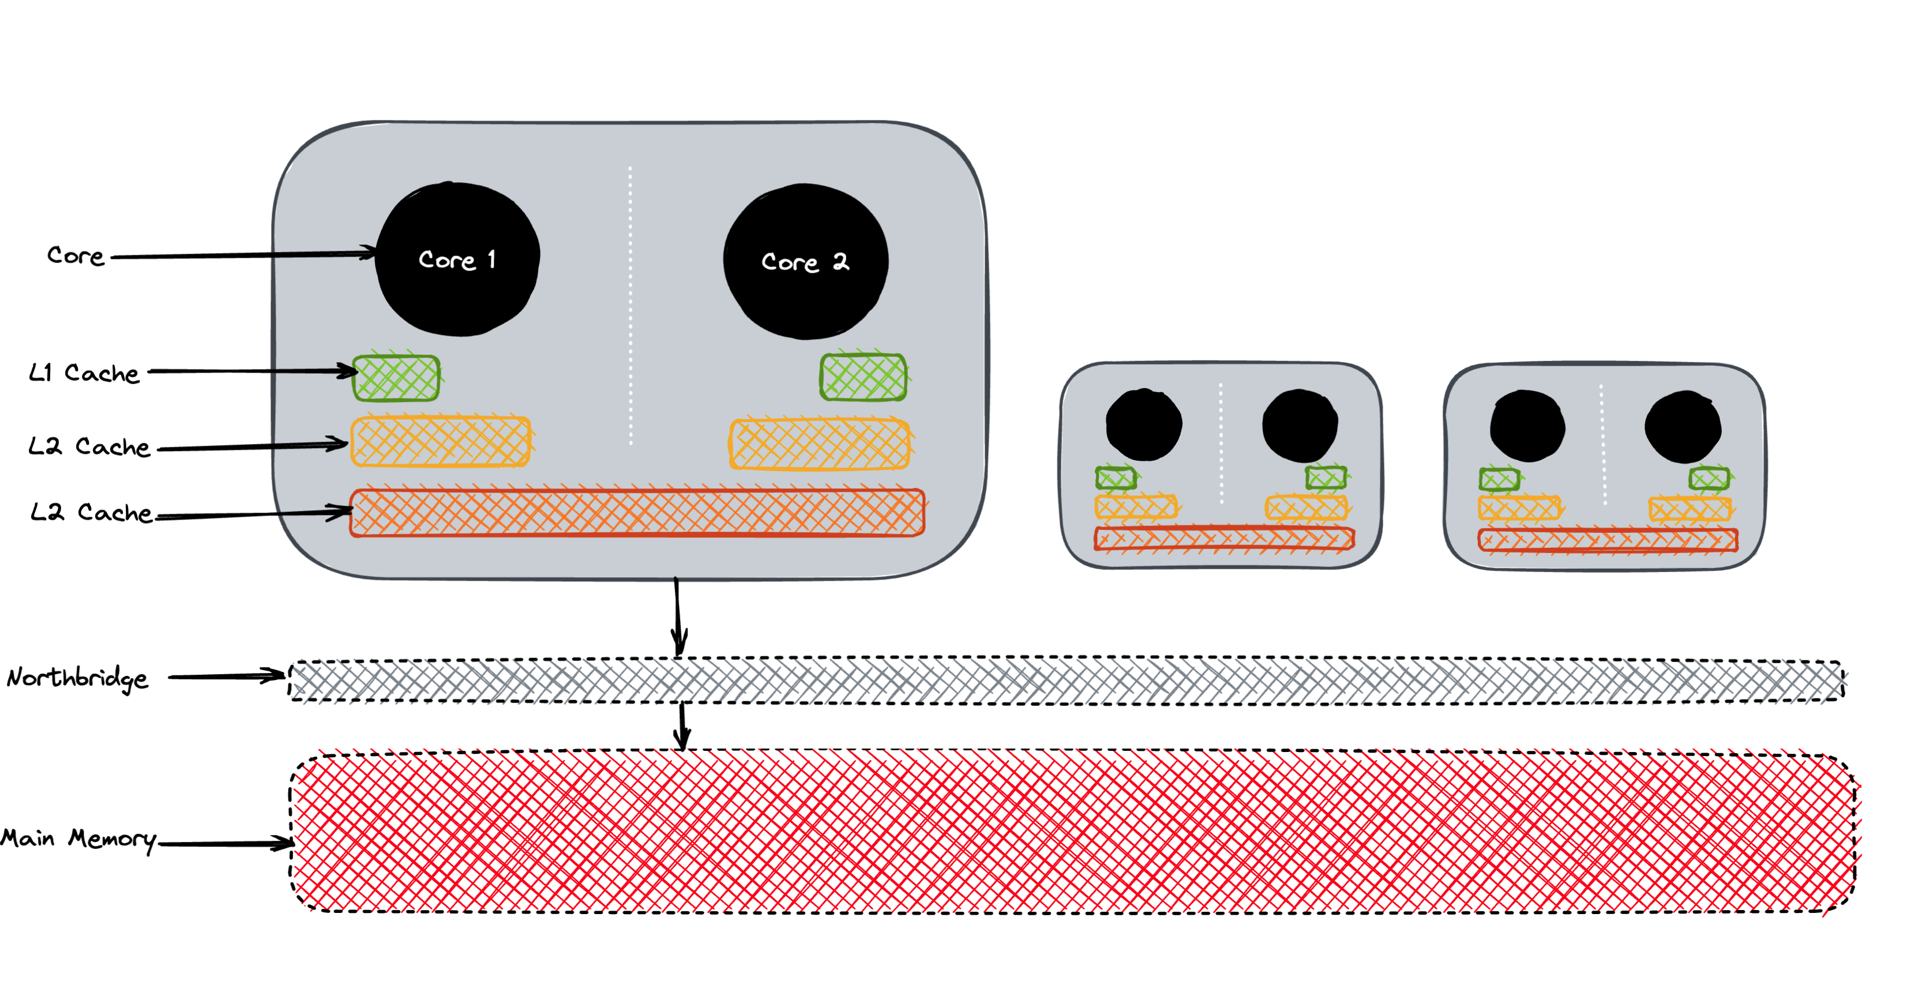

Slide 27
Visibility
A variable is said to be visible
If the writes made on it are visible
All the synchronized writes are visible.

Slide 28
Synchronization and visibility
Synchronization: Guarantee the exclusive execution of a block of code
Visibility: ensure the consistency of the variable
All shared variables should be accessed in a synchronized or volatile way.

Slide 29
Takeaways
A variable is shared among multiple threads, and when one of them writes to the variable, then that’s a critical section.
The critical section has to be guarded by a lock. Otherwise, a race condition will happen.
We can use synchronized keywords. Any object can be used as a lock in Java. However, every object has an intrinsic lock or a monitor lock. The intrinsic lock is used if we use a synchronized keyword in the method signature.
The synchronized block works as an atomic operation, even if it has more than one statement.
The shared variable does not need to use a volatile keyword if we use a synchronized block over a critical section. The synchronized keyword itself removes the visibility problem.

Slide 30
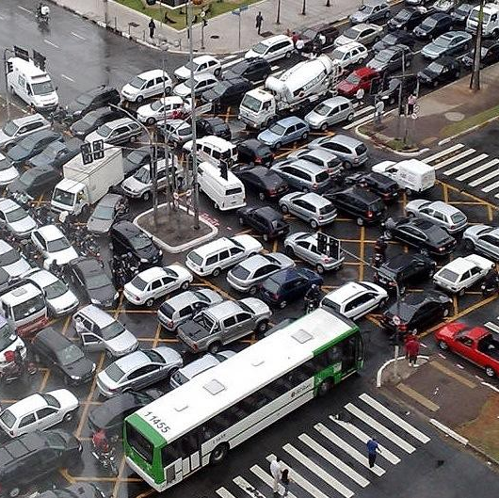
Dead Lock
It usually happens when several threads block each other.

Slide 31
final Object lockA = new Object(); final Object lockB = new Object(); Thread t1 = new Thread(() -> { synchronized (lockA) { sleep(); synchronized (lockB) { compute(); } } });
Thread t2 = new Thread(() -> { synchronized (lockB) { synchronized (lockA) { compute(); } } });

Slide 32
How to avoid dead lock
Avoid nested locking
Lock Ordering, avoid cyclic dependency in lock acquisition.
Use Advance Locking ( e.g, ReentrantLock with tryLock())
Thread t1 = new Thread(() -> { synchronized (lockA) { sleep(); synchronized (lockB) { compute(); } } });
Thread t2 = new Thread(() -> { synchronized (lockA) { synchronized (lockB) { compute(); } } });

Slide 33
Concurrent APIs
Locks
Semaphore
Atomics
BlockingQueue
Latches
Executors
Concurrent Libraries

Slide 34
Reentrance Lock
It’s an implementation of the interface Lock.
It offers the same guarantee as synchronization + more functionalities.

Slide 35
Benefits
Interruptible lock acquisition: lock.lockInterruptibly()
Timed lock acquisition: lock.tryLock()
Fair lock acquisition: new ReentrantLock(true);

Slide 36
ReadWriteLock
It allows multiple threads to read a certain resource, but only one to write it, at a time.

Slide 37
CountDownLatch & CyclicBareer

Slide 38

Thread Pool
Creating threads Ad hoc basis expensive
Threads are limited

Slide 39
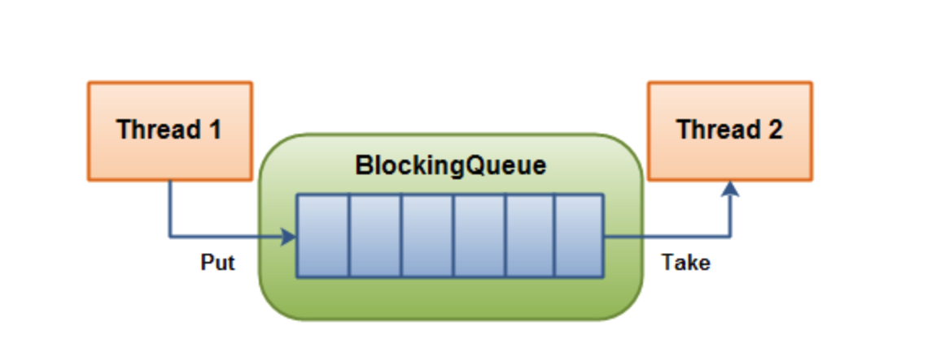

Slide 40
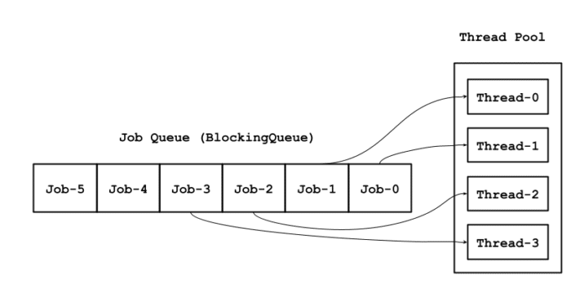
EXECUTORS

Slide 41
Executors
Exectors.newFixedThreadPool(int nThreads):
Executors.newCachedThreadPool()
Executors.newSingleThreadExecutor()
Executors.newScheduledThredPool(int corePoolSize)

Slide 42
Runnable vs. Callable
Runnable: when we don’t need a result
Callable: when we need results.

Slide 43
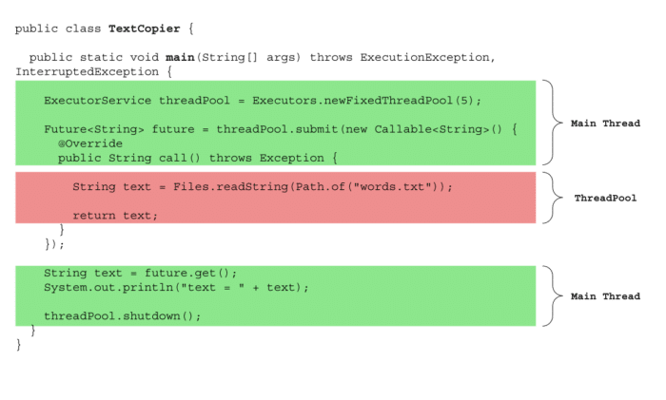

Slide 44
Fork/Join Pool

Slide 45
Parallel Stream

Slide 46

Virtual Threads

Slide 47
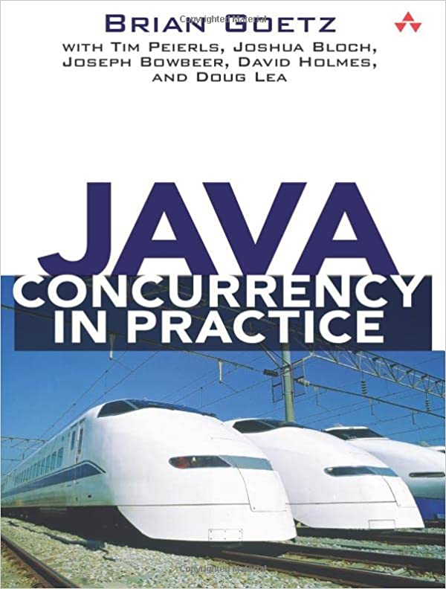

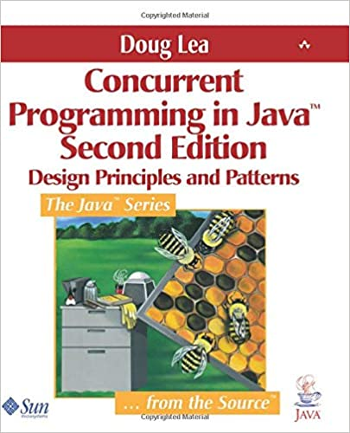
RESOURCES
Java Concurrency in Practice - B. Goetz et al.
Concurrent Programming in Java - D. Lea
Optimizing Java - B. Evans et al.
https://foojay.io/today/author/bazlur-rahman/
https://jenkov.com/tutorials/java-concurrency/index.html

Slide 48


Thank you
https://twitter.com/bazlur_rahman

